Slide 1

CHITCHAT

Slide 2
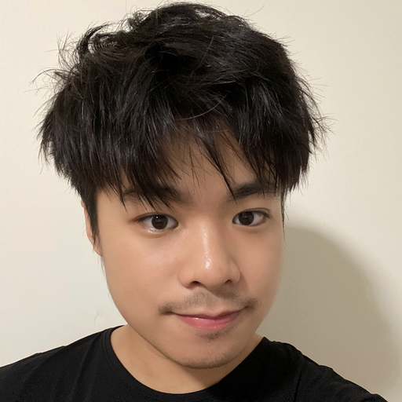

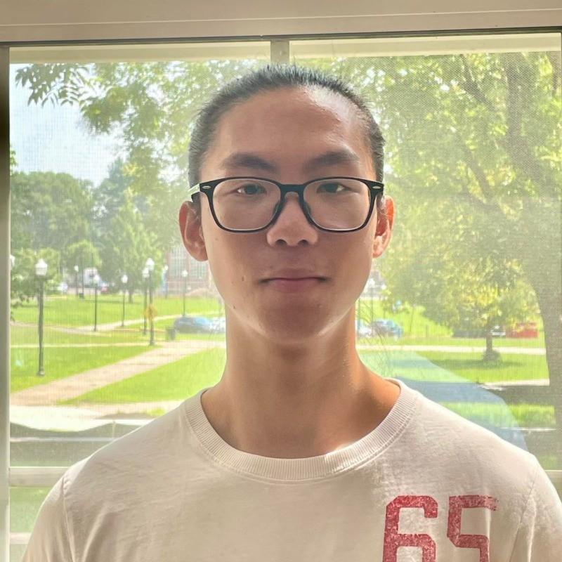

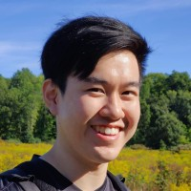

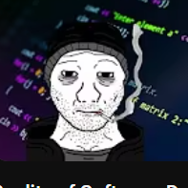
MEET OUR TEAM
Robert Ortiz
Felix Chen
Jay Chen
Eric Zheng​
Full Stack Web Developer
Full Stack Web Developer
Full Stack Web Developer
Full Stack Web Developer

Slide 3





Problem Statement
Current forums tend to be packed with an abundance of functionalities that can be distracting and hinder the core objective: fostering meaningful conversations and connections. This feature-heavy approach often leads to user frustration, reduced engagement, and a diluted sense of community.
Our solution:
At ChitChat, Our approach is centered around a streamlined old philosophy of quality over quantity.
By distilling the forum experience down to its core purpose, we create an environment where users can engage in focused, real-time conversations without the noise and clutter of excessive features.

Slide 4
Development Approach and Challenges
Challenges Faced:
Feature Overload Temptation: The team grappled with the challenge of balancing the urge to include numerous features against the risk of overwhelming users and diluting the conversation-centric concept.
Adapting Next.js with Authentication: Integrating Next.js into the project, particularly handling authentication seamlessly, proved to be a notable challenge.
Real-time Conversations : Implementing seamless, responsive, and synchronized real-time branching conversations demanded overcoming intricate technical obstacles.
Agile Methodology with a Scrum Focus:
ChitChat was developed using Agile principles, specifically leveraging the Scrum framework. This approach enabled iterative development, user(us) feedback incorporation, and adaptive planning.

Slide 5
Architecture
FrontEnd/SRC
│
├── app
│ ├── context
│ ├── create
│ ├── layout.js
│ ├── page.js
├── component
│ ── Nav.jsx
├── pages
│ ├── post
│ ├──[id].js
│ ├── CreatePost.jsx
│ └── ...
│
BackEnd
│
├── config
├── errors
├── middleware
│ ├── authenticateUser.js
├── migrations
│ ├── create-post.js
│ ├── create-comment.js
├── models
│ ── post.js
├── routes
│ ├── post.js
│
├── services
│ └── ...
│

Slide 6
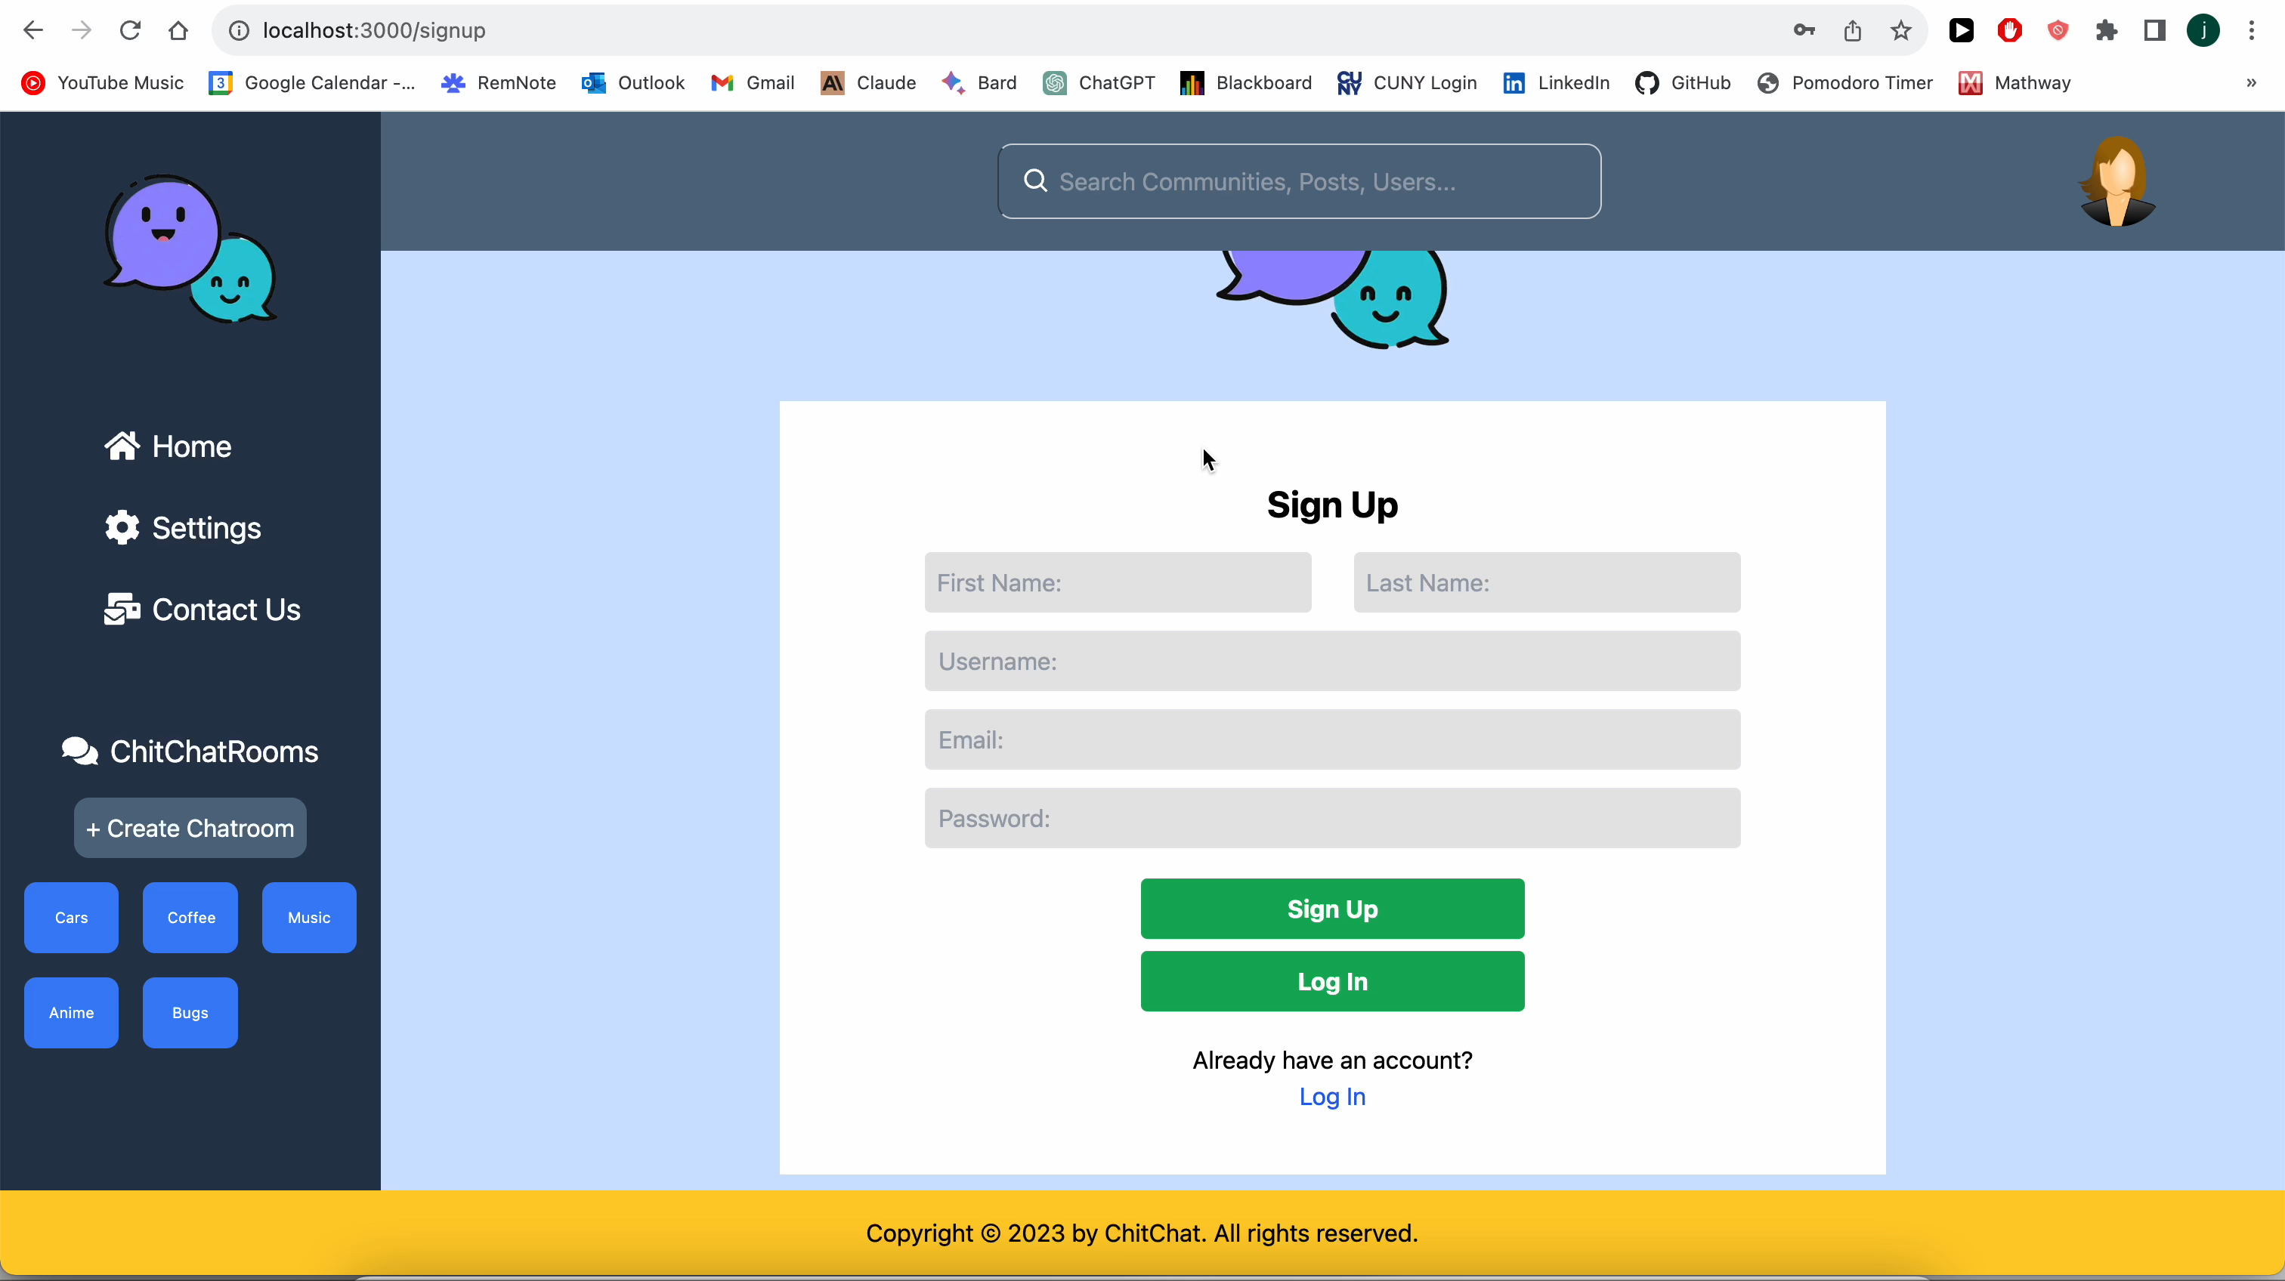
SignUp, Login, Logout Demo

Slide 7
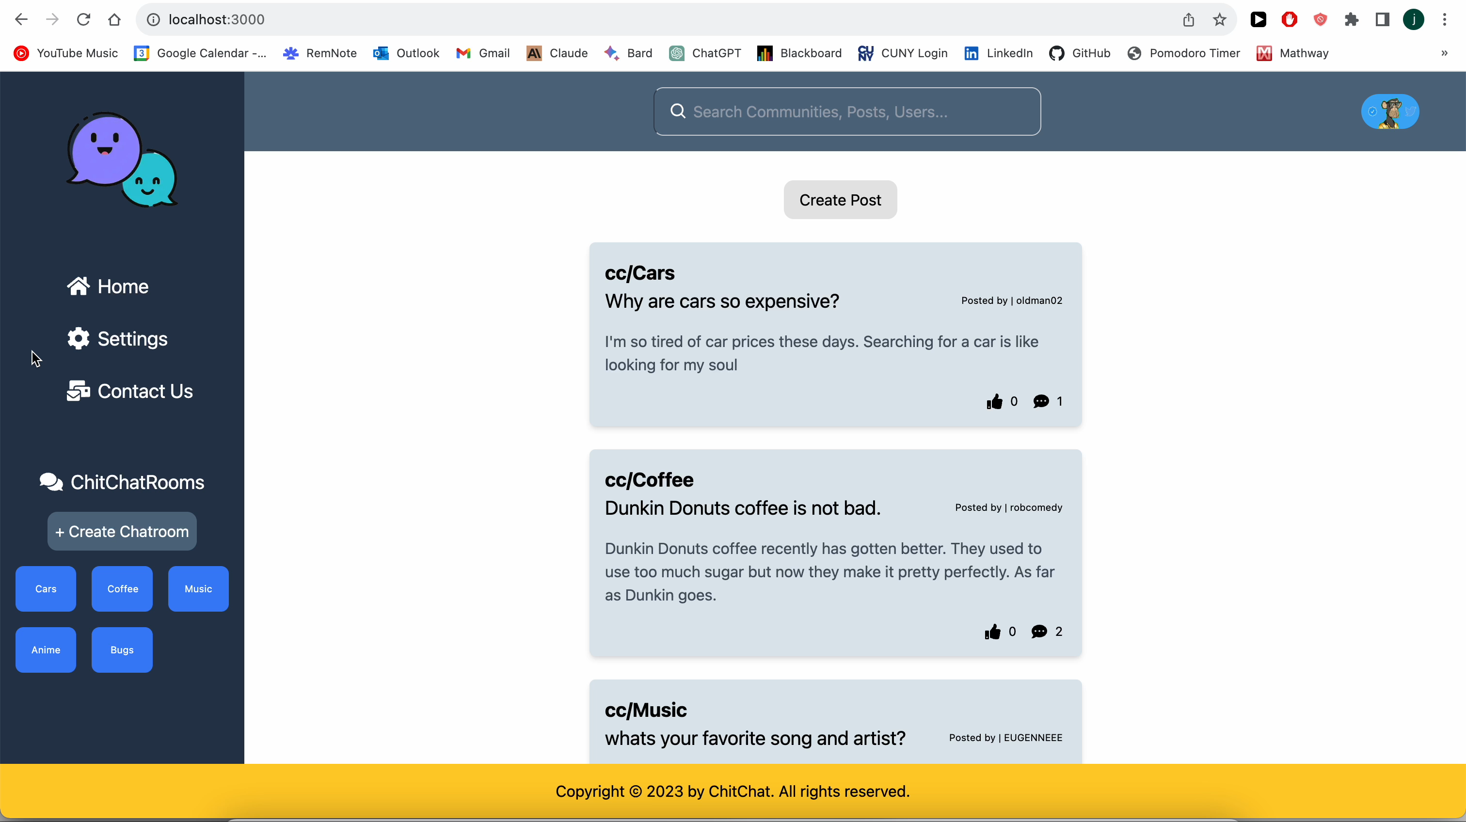
Settings profile demo

Slide 8
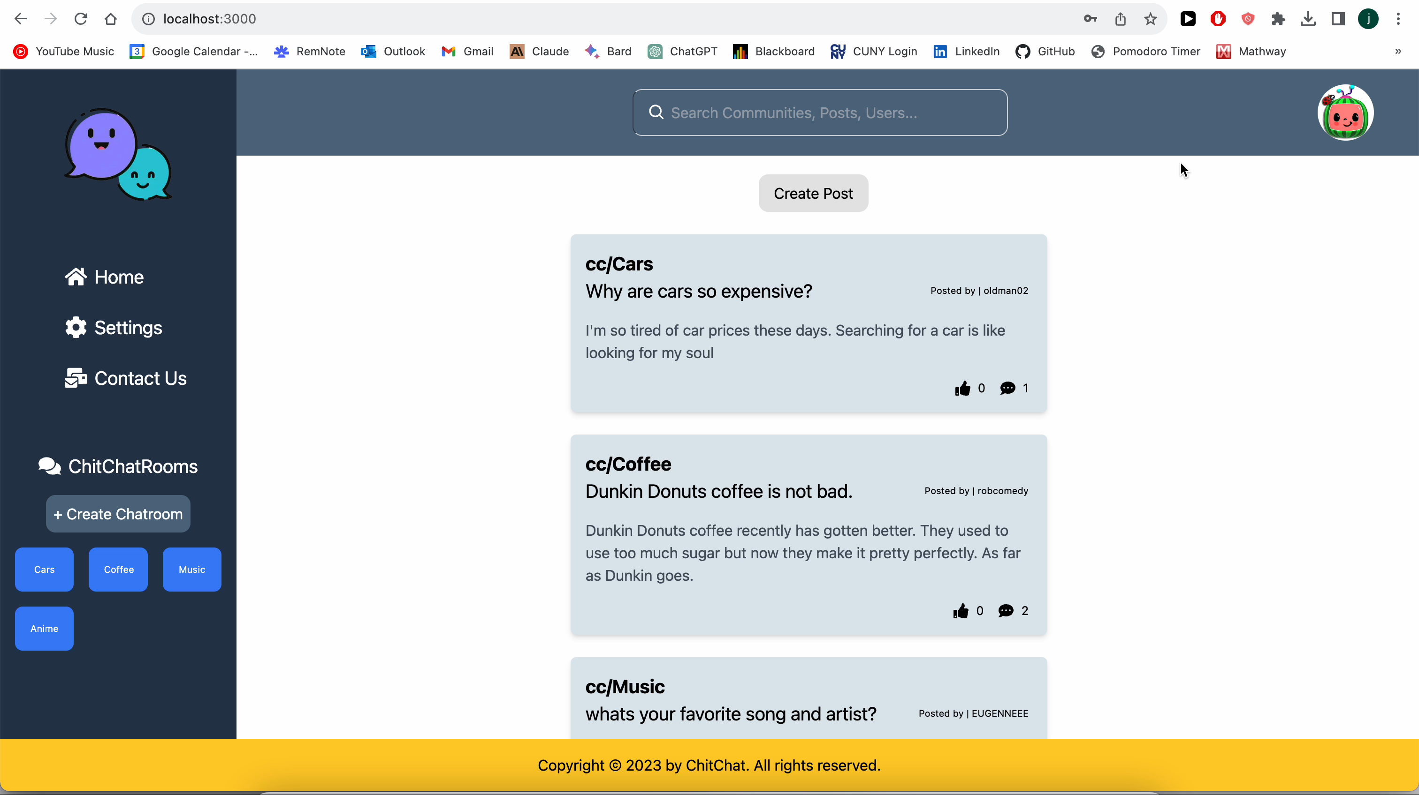
Create post demo

Slide 9

chit chat room Demo

Slide 10

Comments and replies Demo

Slide 12
THANK YOU

